Slide 1
Final Project Presentation
Kid Buddy
Presented By-
Ananya Purkait
Nethra Venkatesh
Swasti Jain
WE Program, Cohort 4

Slide 2
Contents
Aim
Tech Stacks
Workflow
Demonstration
Learnings & Challenges
Future Scope
Conclusion
Notes:
Done

Slide 3
INTRODUCTION
Aim of this project was to learn neural networks and machine learning in order to develop a model that recognize numbers and deploy it into an android application targeting toddlers of the age group three to five years old.
Notes:
I fell swasti can explain this, as she bring in her personal experience of small kids (toddlers) in her house which inspired her to work on such an app and that we wanted to expose the domain of ml and machine learning.
Problem Statement:
In the modern society, children are more interested in digital devices like mobile phones and tablets. Infants' brain development has been shown to benefit from mental exercises. So, by utilizing the benefits of technology, we are creating a game application for toddlers which help them write numbers and practice and stimulate the brain by playing this game. The target audience for this software is infants of age group from 2 to 5 years old.

Slide 4


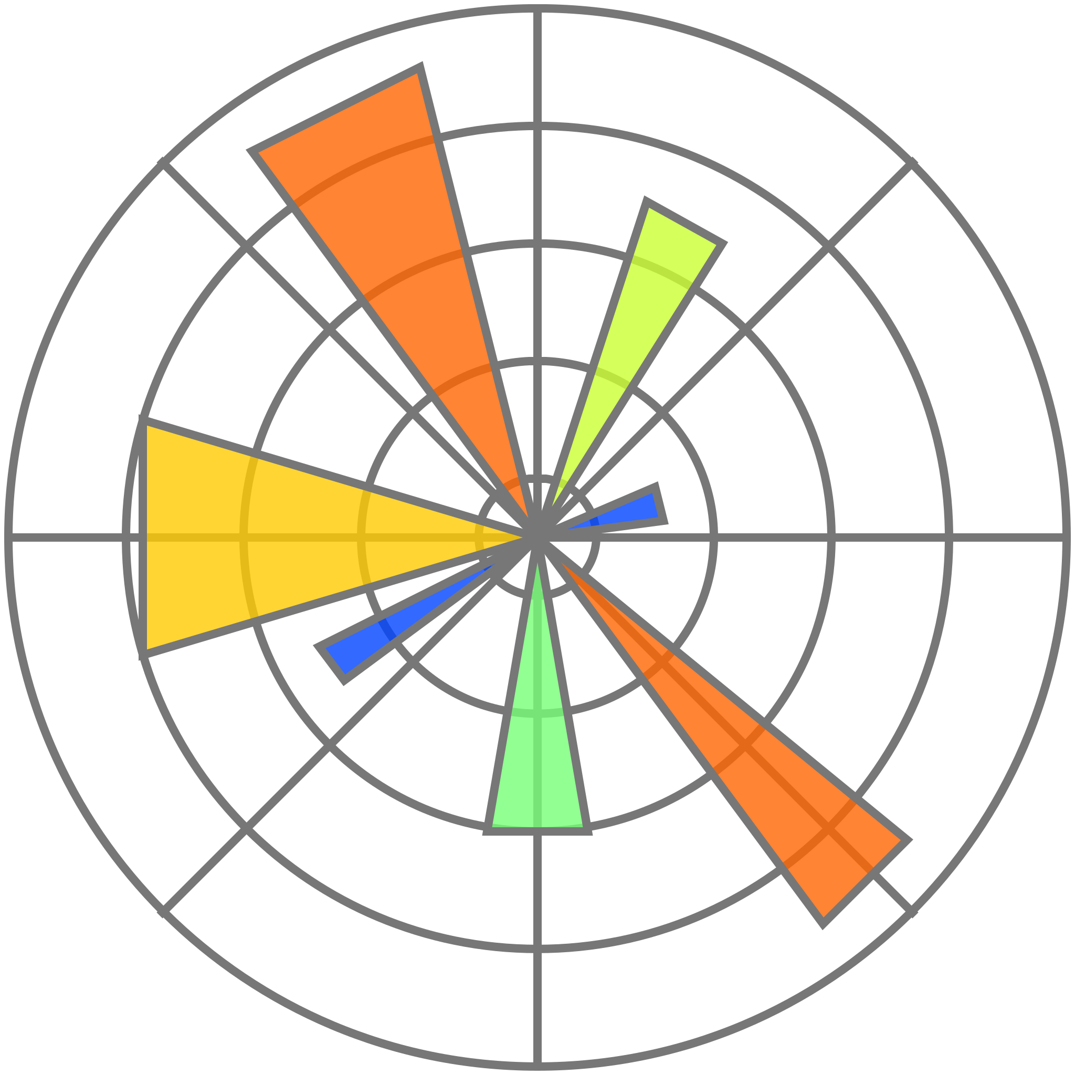



TECH STACKS
MACHINE LEARNING
TensorFlow
Keras
Numpy
MatPlotLib
Android Development (using Kotlin)
Android Studios
Fire Base
Lottie Animations & Adobe illustrator
Notes:
Done

Slide 5
WORKFLOW

Slide 6
Stage I - ML model
Creating ML model for handwritten digit recognition -
Setting up environment
Loading MNIST dataset
Creating array and scaling of data
Model training
Model fit
Model evaluation
Save model
Handwritten-digit prediction using model -
User input (image)
Grayscaling and array formation from image
Prediction of input by saved model
Converting the model to TFLite form - to deploy it in android studio.
Google Colab Link
Notes:
Add what you performed in simple words - you explain about it in detail
Add in picture of code and numbers

Slide 7
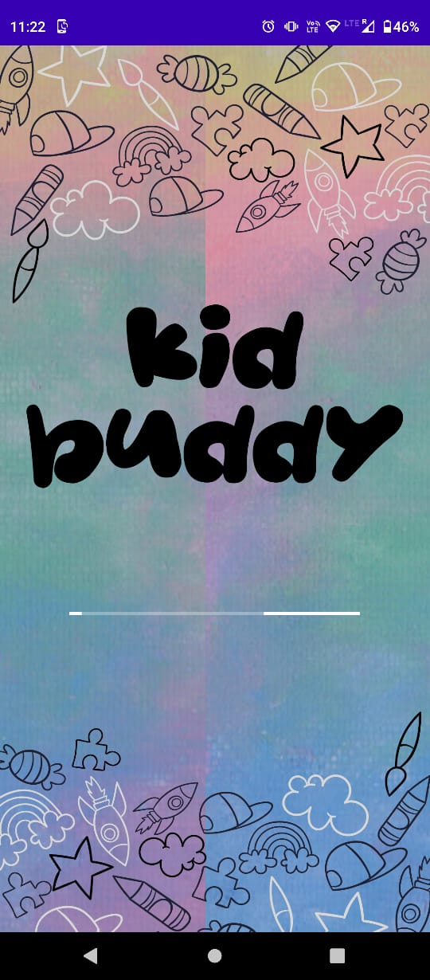
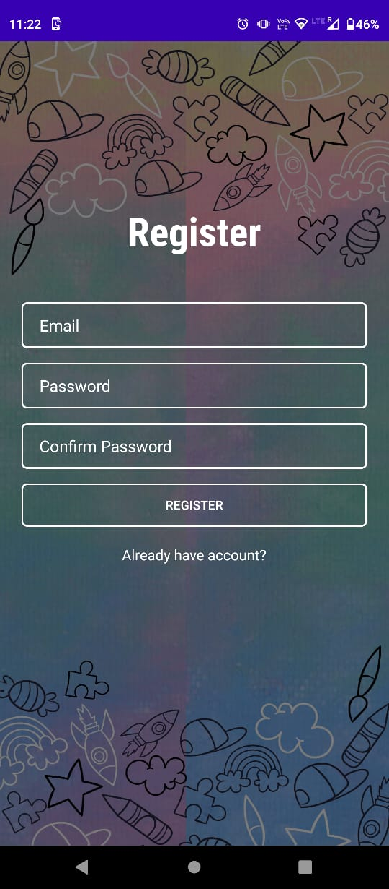
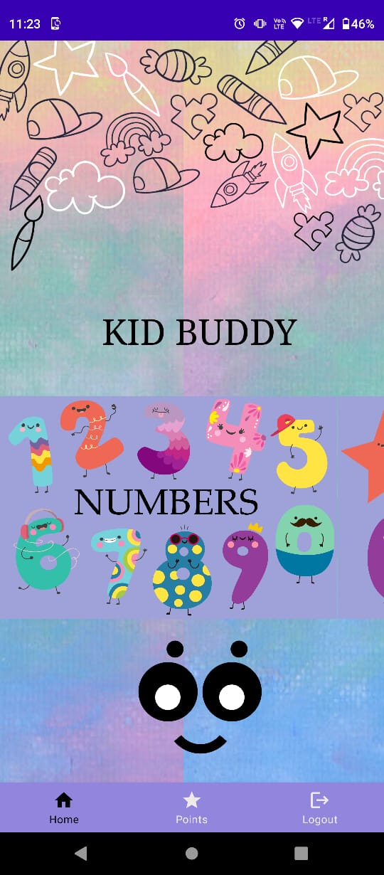
Stage II - User Interface
Splash Screen
Authentication
Home Space
Points and Awards
Notes:
POint kept in mind
Kid friendly
Attractive
Easy to use

Slide 8
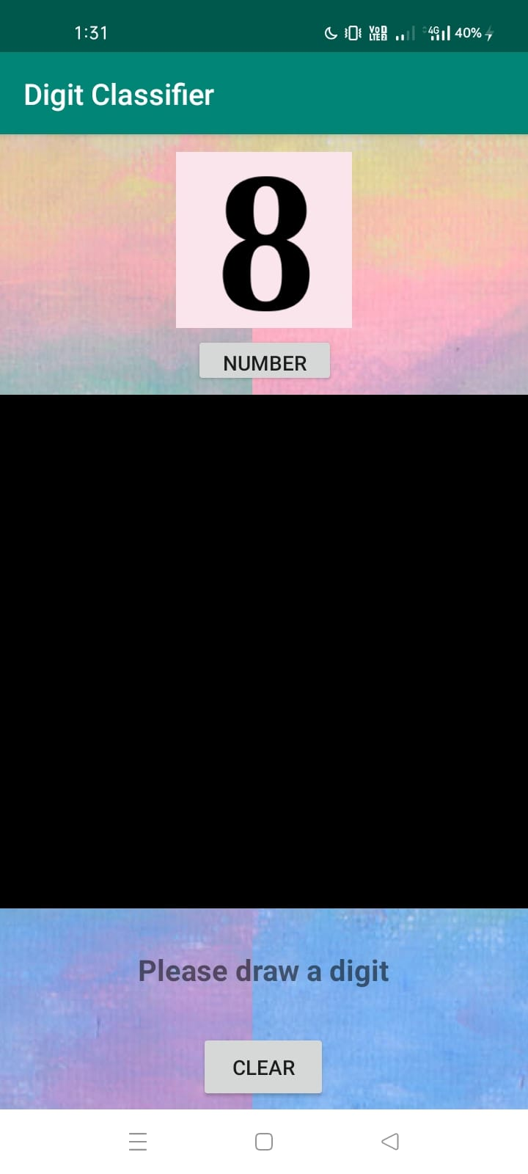
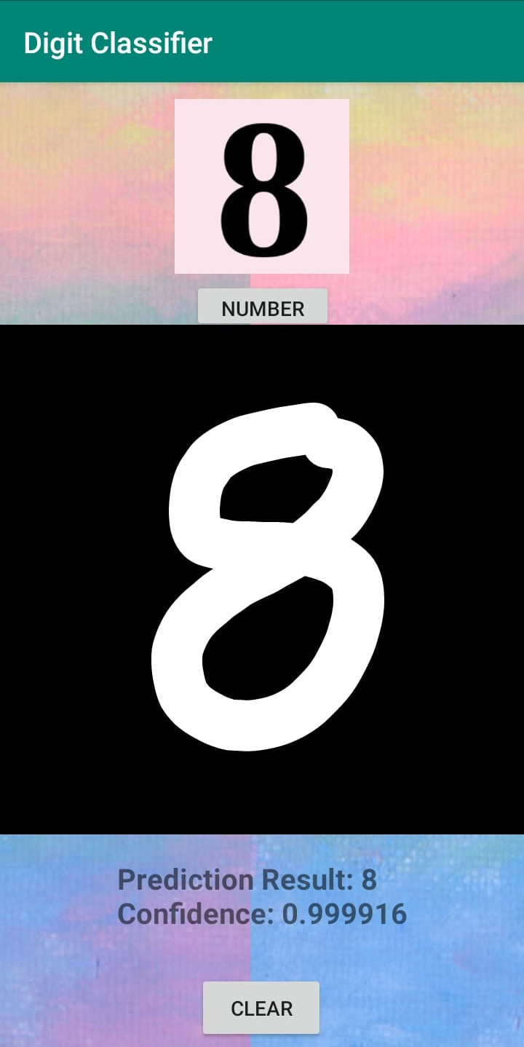
STAGE III - Deployment of ML model in android application
Interface - to merge the android application with the ml model prepared
Random Number Display
Input screen
Output text view
Clear and Number button

Slide 9
Demonstration
Notes:
Practice once with zoom and screen sharing

Slide 10


Slide 11
LEARNINGS & CHALLENGES
Understanding of Neural networks and working with datasets.
Learnt Kotlin and Android Studio from Scratch.
The thinking process behind developing and application.
Collaboration of ML model with android application.
Communication and management while working in group.
Converting user input bitmap image to 28X28 pixels .jpg format.
Converting .ipynb file to TFLite file format.
Notes:
- what all we learn both team work terms and technically

Slide 12
FUTURE SCOPE
Improve upon ML model accuracy.
To develop a more user friendly UI/UX interface.
Develop other models / level into out app, such as Shapes and Alphabets

Slide 13
Conclusion
Our project Kid Buddy helped us get an opportunity to explore the domain of Machine Learning and App development.
For any queries, reach out us:
ananya.purkait.21033@iitgoa.ac.in
nethra.venkatesh.21042@iitgoa.ac.in
swastijainbharat02@gmail.com

Slide 14
Thank you for considering our project.
We look forward to hearing your feedback and suggestions

